Slide 1
Teaching about the Christian Holy Trinity Liz Johnson teaches at Our Lady of Pity Catholic Primary School on the Wirral This PowerPoint sequence supports ideas from Summer 2021’s REtoday magazine pages 24-25 This downloadable resource, free to REtoday magazine subscribers and NATRE members, is © RE Today and may be used in your own school. Any other use is by written permission only.
© RE Today, 2021

Slide 2
Trinity for 6-7 year olds?
Liz: “We strongly believe that we are all inherently good and with the knowledge that every pupil is unique and created in the image of God. Everything in our school is child centred and we encourage all pupils to engage fully with their learning. We encourage each child to develop their potential both spiritually and academically. To support this, our curriculum is inclusive for all so it is designed to enable every pupil to recognise their strengths.”
This perspective leads to a willingness in RE to encourage children from the younger age groups to explore and express spiritual ideas of their own.
Many teachers might think that the Christian concept of Holy Trinity is too hard for 6-7s, but here comes some evidence that they can handle it – rather well.
© RE Today, 2021

Slide 3
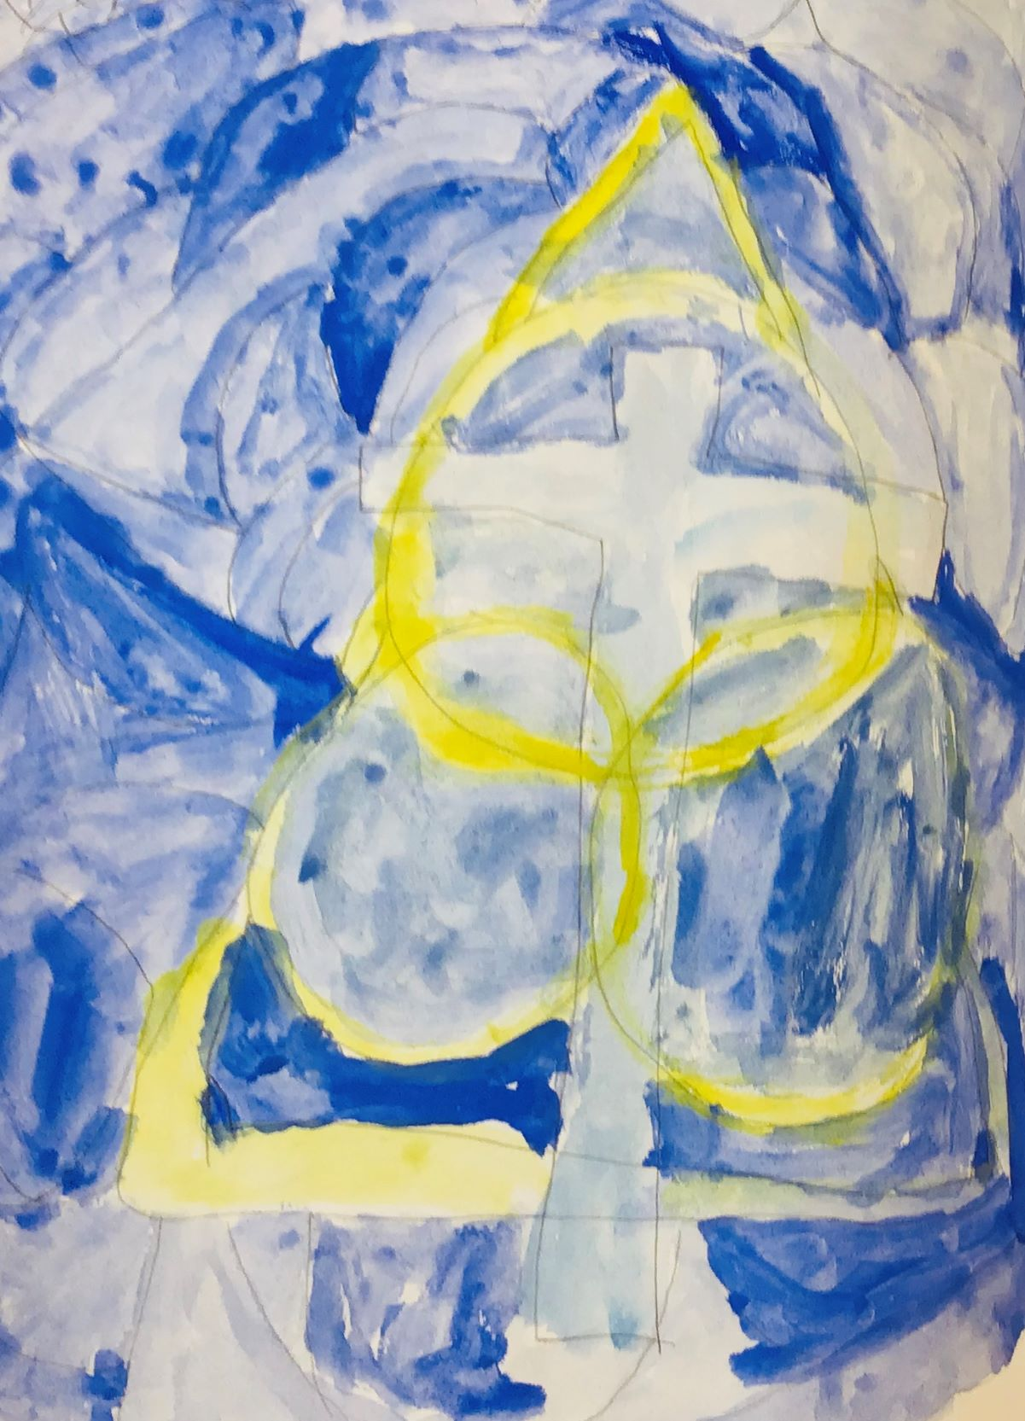
God at the cross
This image shows two symbols of the trinity – a triangle and three interlocking circles, over the cross.
Christians believe that God is one, and that God is known in the Father, Jesus the Son and the Holy Spirit.
The image has a mood that is both calm and bright.
© RE Today, 2021

Slide 4
Artists to model and inspire
Liz: “We want RE to allow the children to explore their gifts that God has given them. Therefore, in setting this work, my intentions were to help Year 2 children to access and develop an understanding of the Holy Trinity.
The concept of God as the Father, Son and Holy Spirit is difficult for most adults to understand, let alone children. The power of art allows the children to fully immerse themselves in every story, idea and prayer.
After introducing the idea of the Holy Trinity, I presented the children with different artists interpretations of the Trinity. We then talked about colours that were used in each piece of art and what those colours might represent. The children were then commissioned to paint the Holy Trinity as they understood it.”
The results show some deep awareness and understanding from this age group.
You can easily find interesting ‘art of the trinity’ through an online search. Use three to five examples with your class.
© RE Today, 2021

Slide 5
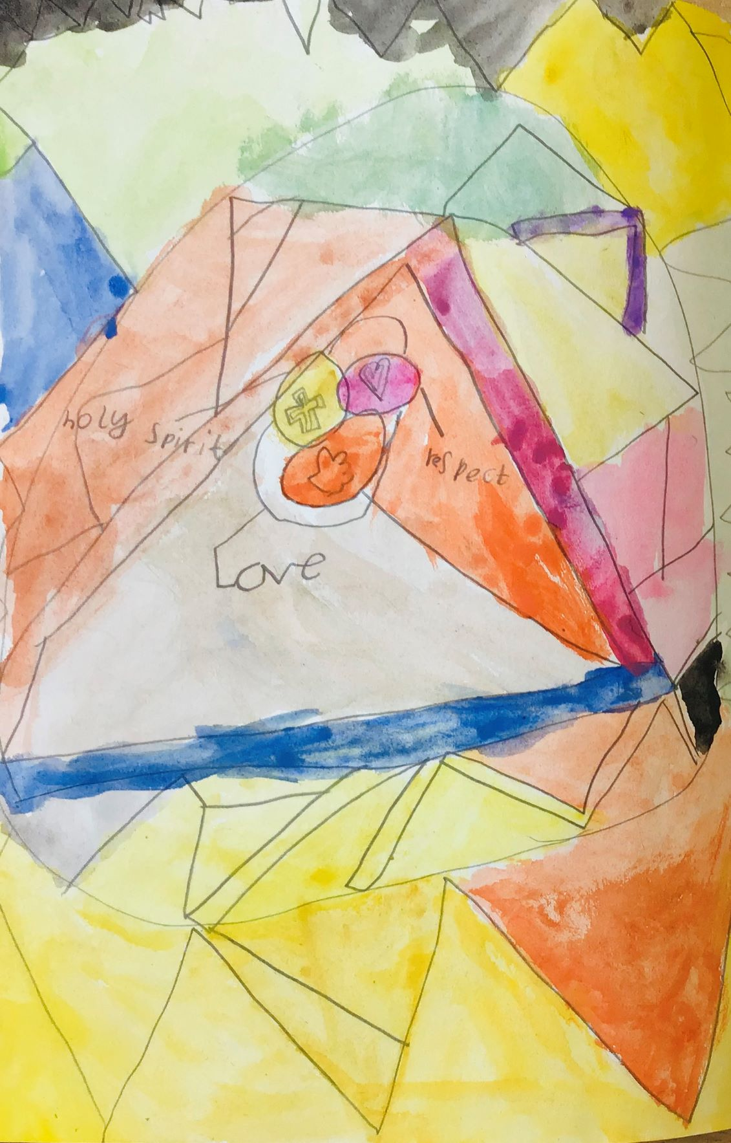
Triangles of love, respect and spirit
This image uses triangles and circles, with colour washed paint.
This pupil wanted to use the words ‘love and respect’ to convey an idea of God which humans might copy.
The image uses all the colours of the rainbow. Pupils need time, and decent art kit, as well as models from other artists, to produce work like this.
© RE Today, 2021

Slide 6
I become the learner
Liz: “I wasn’t sure how successful this was going to be but with each step I became more amazed. The responses from the children were overwhelming. Not only did they quietly and respectfully begin to draw and paint but they thought about each symbol and every colour. As their paintings developed, I became the learner as the power of art took over. Through painting each symbol, the children’s knowledge and understanding of the Trinity grew as they thought about what they could use to represent the three concepts. They were able to discuss their ideas with confidence and explain to each other ideas about what the Holy Trinity is.
The art helped their confidence grow and not only did the paintings develop, but so did their words and explanations. What impressed me was that every piece of art was different, yet they all represented the same idea. Every pupil has included three; some with three rings, triangles or hearts.
Children wanted to represent the idea of love and the beliefs that God loved us so much that He created a world for us to live in and look after, that He sent Jesus to represent Him on earth. The heart also shows the Holy Spirit living within.”
© RE Today, 2021

Slide 7
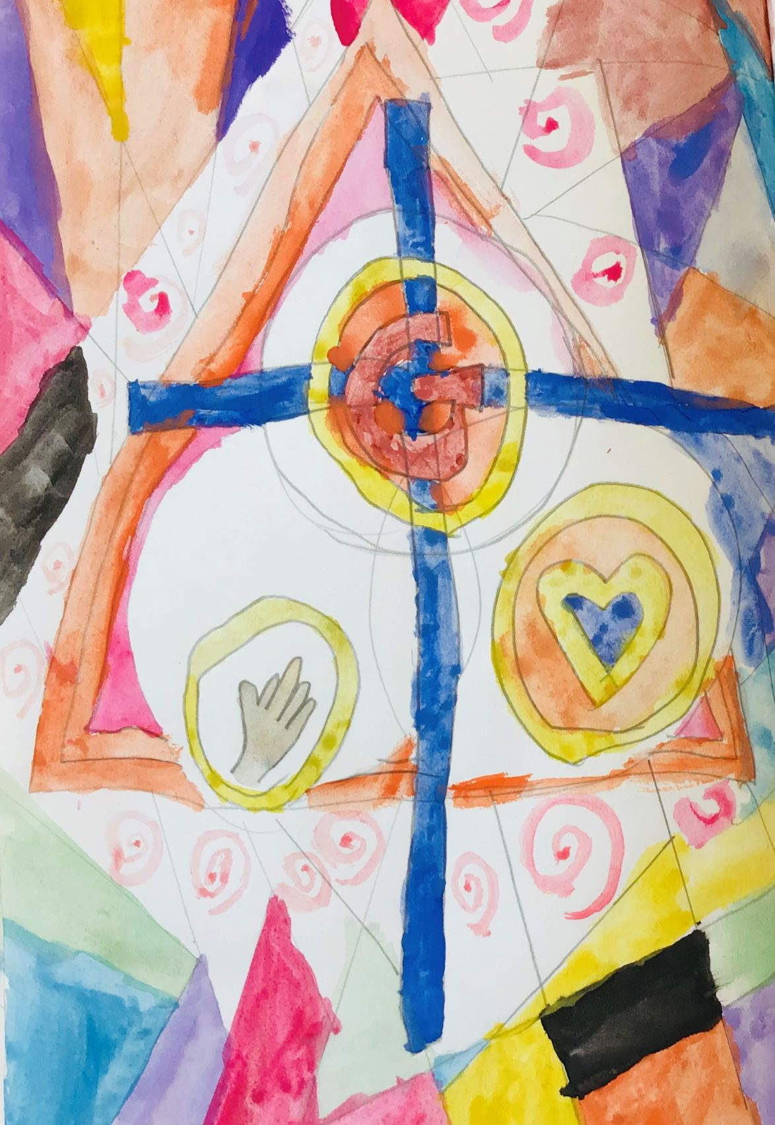
Detailed symbolism and calm colour
Does this way of working give, as Liz suggests, confidence to pupils who struggle with words? Depth to a difficult concept? Diversity in the expressions children make?
In the context of Christian education, Liz talks about the children’s own experience of the Spirit. That might be put differently in a plural school.
© RE Today, 2021

Slide 8
Bright? Calm? Peaceful? Brave?
Liz: “The colours that were used, although some are bright, all had a calming feel to them; they almost speak to us with joy, love and peace. I watched as the children used water to change the tones of the colours, almost as if knowing that they needed to have a sense of calm.
I asked the pupils what they had enjoyed about the lesson and ‘calming’ was the word most used. How profound for 6 year olds to use that word.
I learned that what I believed to be a challenge was quite the opposite. As educators, we quite often focus on the objective of the lesson and what we need to do to support the children in reaching it. Being creative has taught me that, particularly in RE, we need to be brave and allow the children the freedom to show us what they are capable of. Doing this through art does not frighten the children who can’t find the words to express themselves. Instead, it gives them freedom. We talked about the Holy Spirit living in human hearts to guide people: I believe that in this lesson, the children could allow faith and deep thinking to flow. My children have now become an inspiration to me.”
© RE Today, 2021

Slide 9
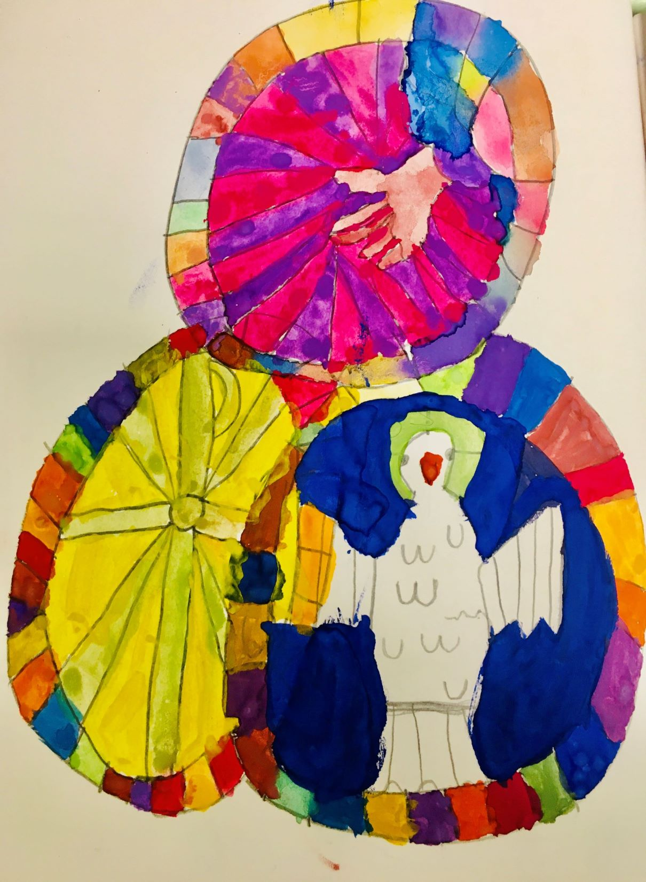
Extraordinary images from many children
Look at the care with which this image has been designed and made. Like a stained glass window, its rich colours express ideas with beauty.
Can your pupils engage at this level with a big belief idea from Christianity – or from another faith?
What can anyone learn from the example Liz has set?
© RE Today, 2021

Slide 10
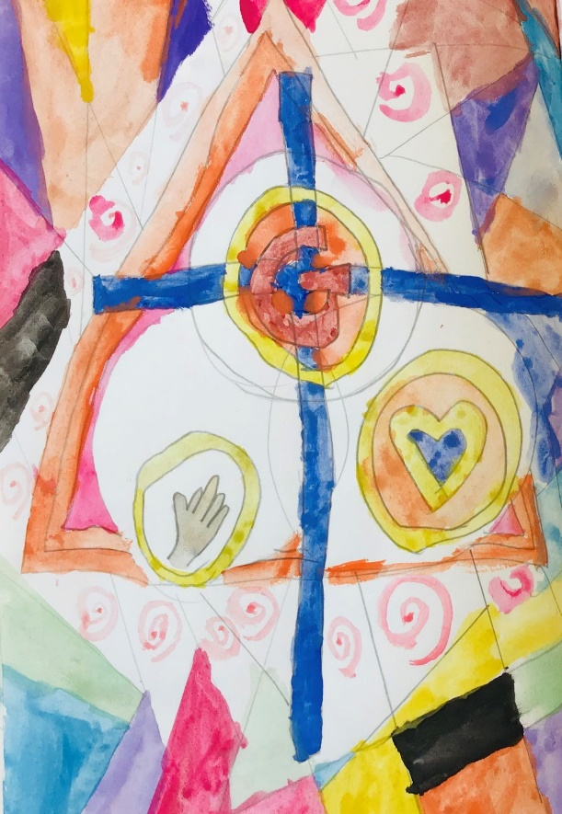
Choose a favourite
© RE Today, 2021

Slide 11
This PowerPoint sequence supports ideas from Summer 2021’s REtoday magazine, pp. 24–5. Thanks to Liz Johnson for her work and all her pupils for their creativity. This downloadable resource, free to REtoday magazine subscribers and NATRE members, is © RE Today and may be used in your own school. Any other use is by written permission only.
© RE Today, 2021

